Slide 1



WP1.2
BS 1-1 Presentation Teams
KU Leuven – The SySi
Lieve Helsen et al.
Expert Meeting Berlin
February 27-28, 2018

Slide 2
KU LEUVEN – FACTS & FIGURES
KU LEUVEN since 1425
57 346 students
Largest university in Belgium
All academic disciplines
14th European in Times Higher Education
1st European in Most Innovative Reuters
EU funding: 1st MSCA-ITN, 6th FP7 and H2020
Notes:
KU Leuven boasts a rich tradition of education and research that dates back six centuries. The university’s basic research orientation has always been and will remain fundamental research. At the same time, the university remains vigilantly open to contemporary cultural, economic and industrial realities, as well as to the community’s needs and expectations. From a basis of social responsibility and scientific expertise, KU Leuven provides high-quality, comprehensive health care, including specialised tertiary care, in its University Hospitals. In doing so it strives toward optimum accessibility and respect for all patients.
KU Leuven is currently by far the largest university in Belgium in terms of research funding and expenditure (EUR 466.55 million in 2016), and is a charter member of LERU. KU Leuven conducts fundamental and applied research in all academic disciplines with a clear international orientation. In the Times Higher Education ranking KU Leuven is ranked as the 14th European university, while in the Reuters Top 100 of the World’s most innovative institutions, KU Leuven is listed as the first European university.
Leuven participates in over 540 highly competitive European research projects (FP7, 2007-2013), ranking sixth in the league of HES institutions participating in FP7. In Horizon 2020, KU Leuven currently has been approved more than 260 projects and is ranked sixth HES institution with regard to number of signed grants. KU Leuven takes up the 10th place of European HES institutions hosting ERC grants (as first legal signatories of the grant agreement). To date, the 107 ERC Grantees (including affiliates with VIB and IMEC) in our midst confirm that KU Leuven is a breeding ground (55 Starting Grants) and attractive destination for the world’s best researchers. The success in the FP7 and Horizon 2020 Marie Sklodowska Curie Actions is a manifestation of the three pillars of KU Leuven: research, education and service to society. In our 229 Actions, of which 111 Initial/European Training Networks, hundreds of young researchers have been trained through research and have acquired the necessary skills to transfer their knowledge into the world outside academia. KU Leuven has been or is currently participating in 29 ITNs as coordinator, and 82 as beneficiary under FP7 and Horizon 2020.” In Horizon 2020, KU Leuven is ranked first institution of higher education with regard to number of MSCA-ITNs ‘(54) and second for all entities.
KU Leuven employs 8,084 researchers on its academic staff (2015). To strengthen international collaboration, KU Leuven has its own international research fellowship programme and supports international scholars in international funding applications. KU Leuven Research & Development (LRD) is the technology transfer office (TTO) of the KU Leuven. Since 1972 a multidisciplinary team of experts guides researchers in their interaction with industry and society, and the valorisation of their research results (110 spin offs, …) .

Slide 3
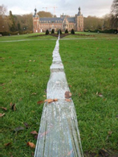
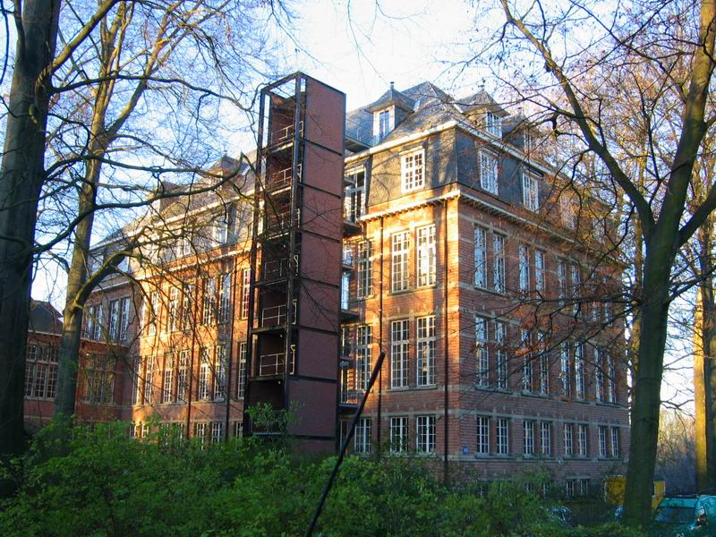
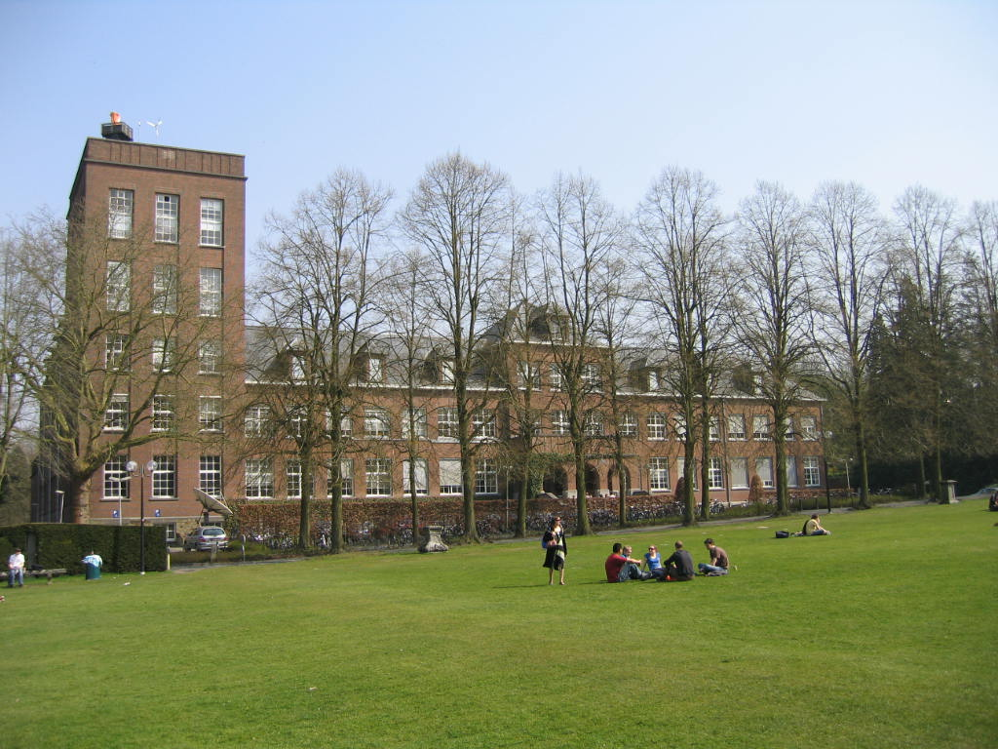

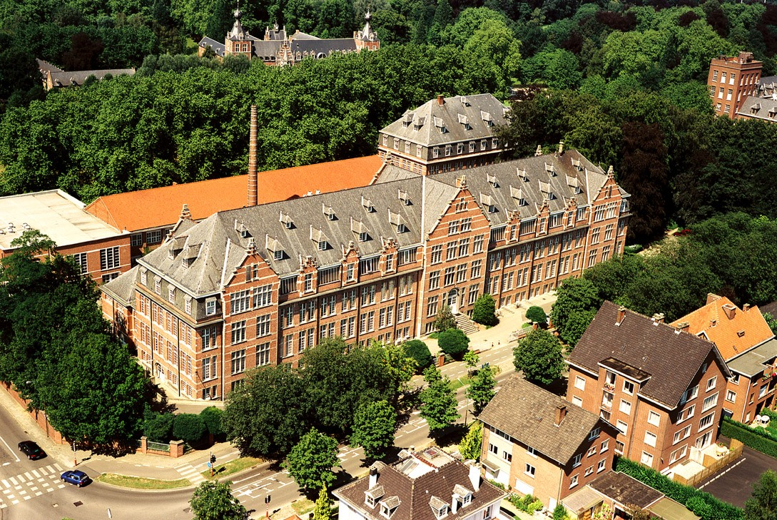
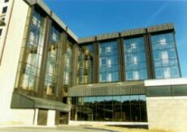
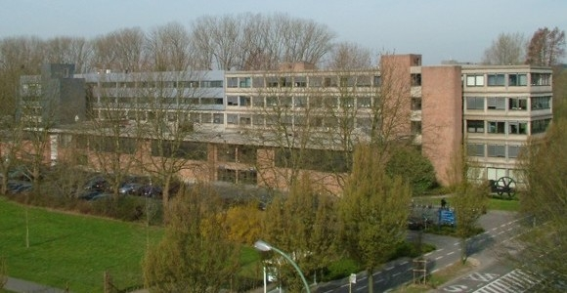
FACULTY ENGINEERING SCIENCE
Research
7 research departments 6 ERC advanced grants - 8 ERC starting grants
> 4000 scientific publications
145 PhD degrees in 2016 (Faculty)
22 spin offs created during the last 3 years
144 patents
Departement of Architecture
Chair
K. De Jonge
PhD stud. 40
ZAP: 15.2
Departement of Civil Engineering
Chair
J. Monbaliu
PhD stud. 42
ZAP: 17
Departement of Electrical Engineering
Chair
B. Nauwelaers
PhD stud. 302
ZAP: 35
Departement of Computer Science
Chair
R. Cools
PhD stud. 128
ZAP: 30
Departement of Materials Engineering
Chair
M. Wevers
PhD stud. 93
ZAP: 14.7
Departement of Chemical Engineering
Chair
P. Moldenaers
PhD stud. 43
ZAP: 12
Departement of Mechanical Engineering
Chair
J. De Schutter
PhD stud. 130
ZAP: 19,9

Slide 4
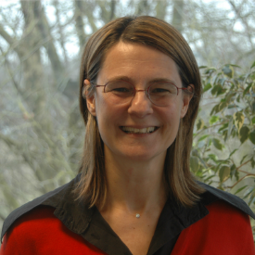
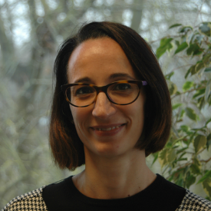

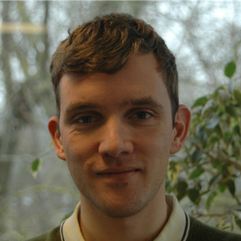
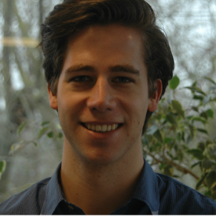
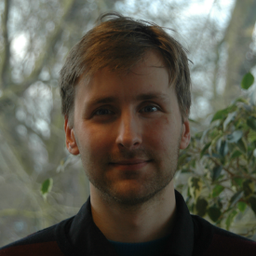
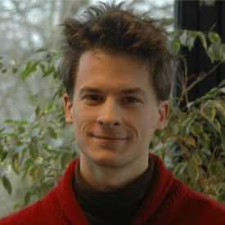
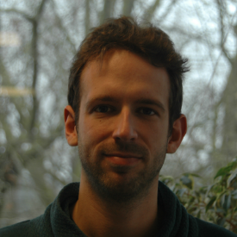
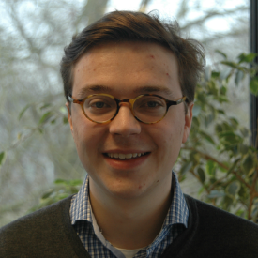
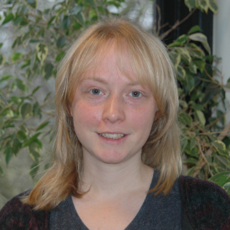
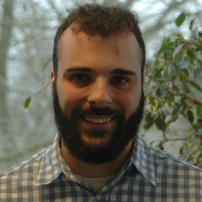
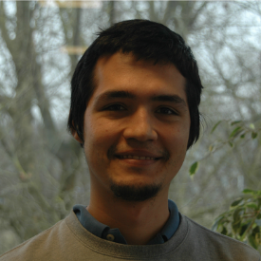
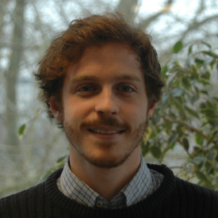
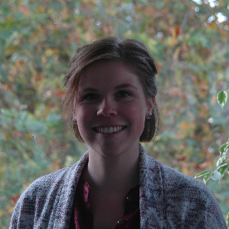
THERMAL SYSTEMS SIMULATION
Thermal Systems Simulation (The SySi) Lieve Helsen, Alessia Arteconi, Dieter Patteeuw, Nicholas Agon, Jan Drgona, Damien Picard, Filip Jorissen, Bram van der Heijde, Annelies Vandermeulen, Iago Cupeiro, Yamid Gomez, Javier Arroyo, Anke Uytterhoeven

Slide 5

Technical expertise:
Simulation: from detailed emulator and controller models (multidisciplinary virtual test bed) to reduced models (object oriented modelling, model order reduction, system identification, model aggregation), including uncertainties
Optimization and Control: optimal design, open and closed loop control, rule based control, model based (predictive) control, robust control, integrated optimal control and design
Experiment: from lab-scale to pilot plant and field tests, verification and validation of models and methods (proof-of-concept and demonstration)

Slide 6
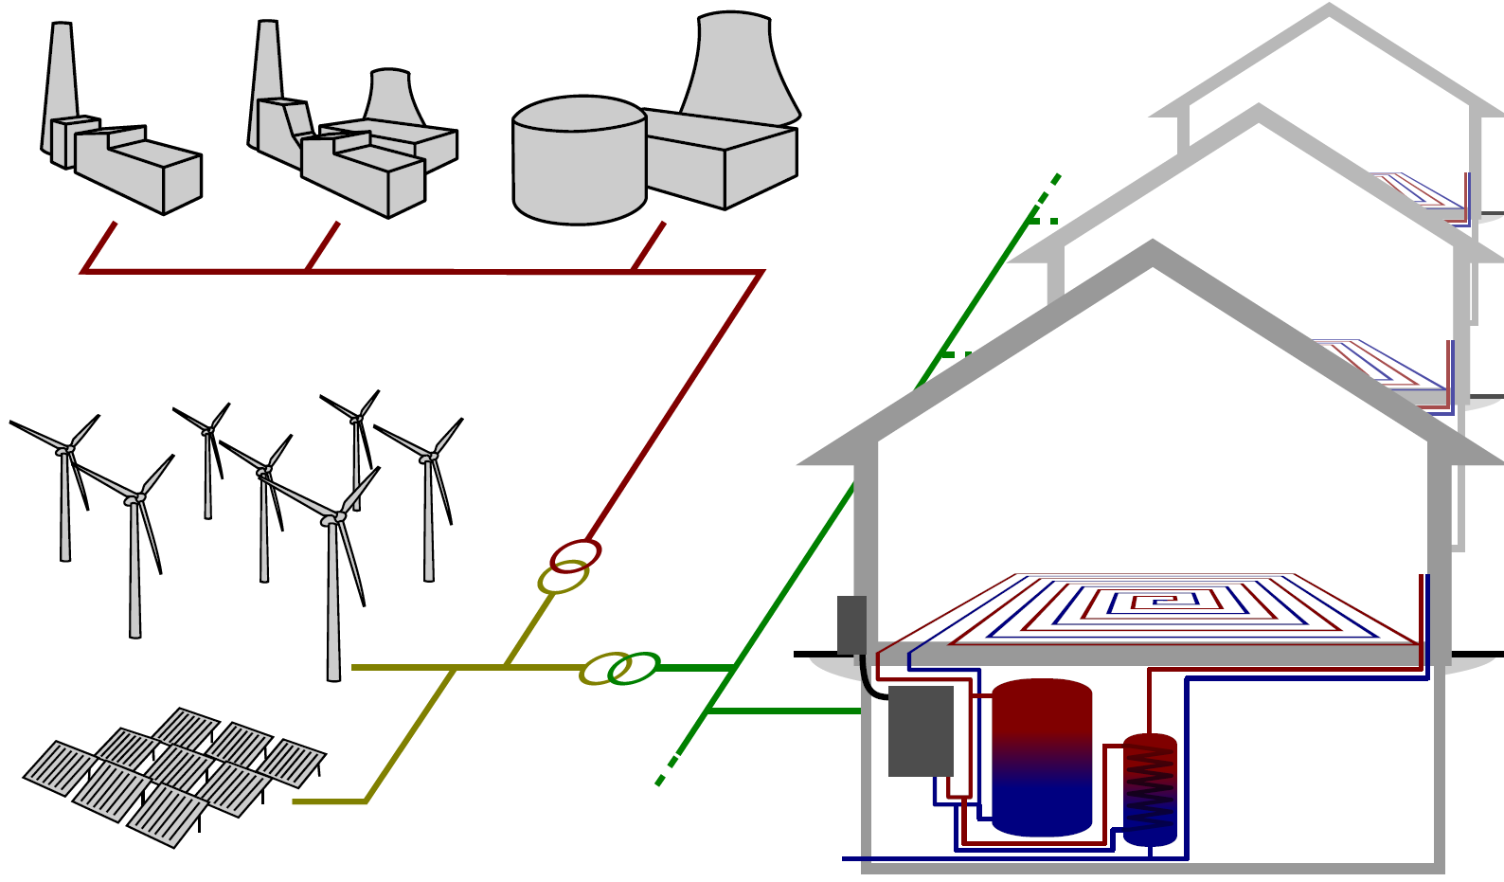
RESEARCH FOCUS
We optimize the performance of thermal systems in various multidisciplinary applications (thermal systems in buildings and waste-to-resources) through integration of system control and design Here system integration is key!
Collaborations → multi-energy carrier systems
Source: Materazzi et al. 2015
Source: KU Leuven – Brecht Baeten

Slide 7
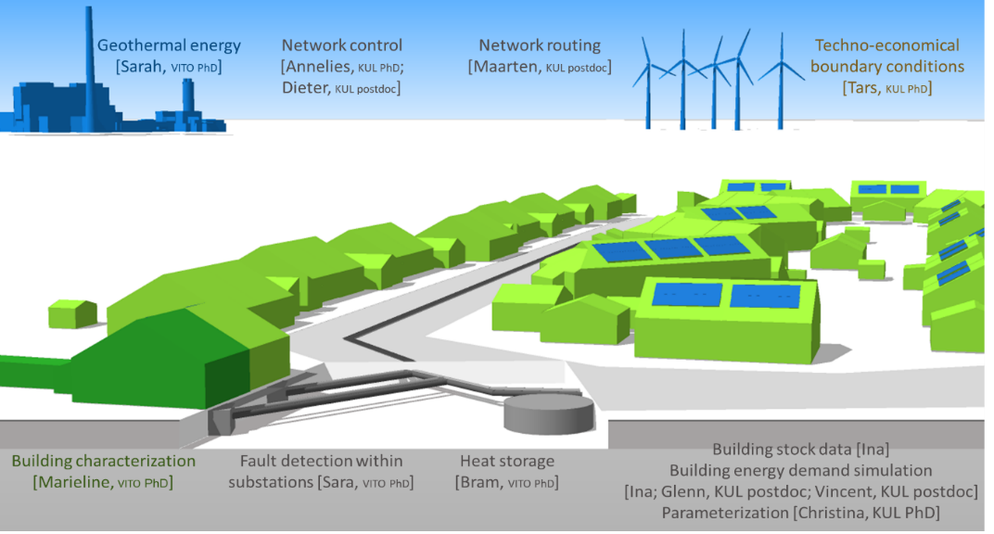

ENABLING TECHNOLOGIES
Energy storage as enabling technology
Thermal networks as enabling technology
Model Predictive Control (MPC) as enabling technology
Unlocking flexibility by dynamic coalitions of power-to-heat/cold resources
Plasma gasification as enabling technology for green energy
Source: KU Leuven – Ina De Jaeger
Source: Ecovat
Source: API

Slide 8
THE KU LEUVEN TEAM FOR WP1.2
Affiliation | Team members
KU Leuven – The SySi | Lieve Helsen
 | Filip Jorissen
 | Damien Picard
 | Iago Cupeiro
 | Javier Arroyo
 | Jan Drgona

Slide 9
WE HOPE TO GET OUT …
IBPSA Project 1, The SySi’s active in WP1.1, WP1.2, WP3
Synergy, critical mass and continuity in development
Dynamic and strong collaborations = seeds for new projects
WP1.2
Open source library for MPC and optimization
Common framework to assess MPC performance
Common architecture, common emulators, common KPIs
Benchmark our MPC formulations
Insights in strengths & limitations of Modelica
Insights in modelling and optimization approaches
Available tools for MPC

Slide 10
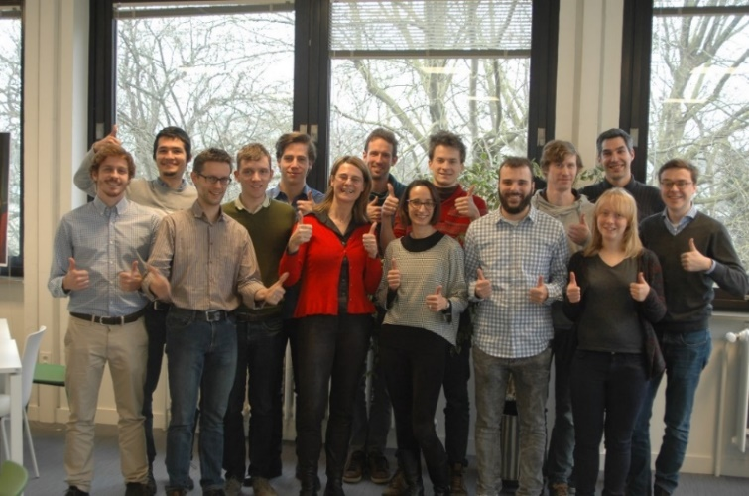
MORE INFORMATION
Team website
https://www.mech.kuleuven.be/en/tme/research/thermal_systems/
Projects:
https://www.mech.kuleuven.be/en/tme/research/thermal_systems/research_projects
Publications:
https://lirias.kuleuven.be/cv?u=U0009689

Slide 11
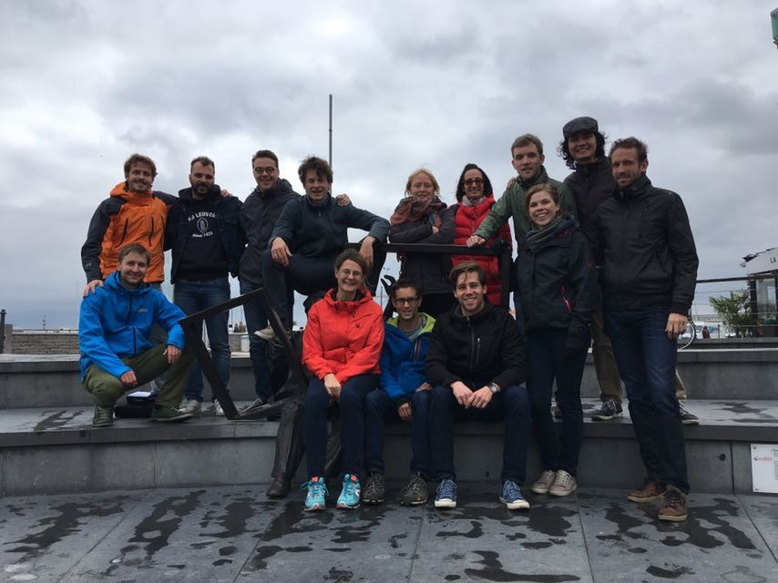
Team of young potentials
passion drives us to problem solutions
Recent Highlights
IBPSA NVL Best Thesis Award
ATIC Thesis Award
EU-H2020-MSCA-ITN NEW MINE project: highest score ever (98%)
Won bid for organizing BS2021 Conference in Belgium
Four EU-H2020 projects running (strong international collaborations)
ELFM seminar in European Parliament
…
http://www.mech.kuleuven.be/en/tme/research/thermal_systems

